Slide 1
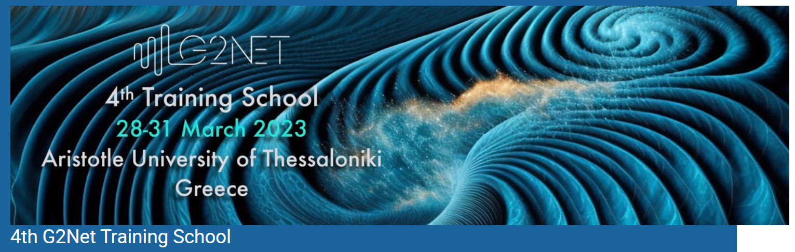
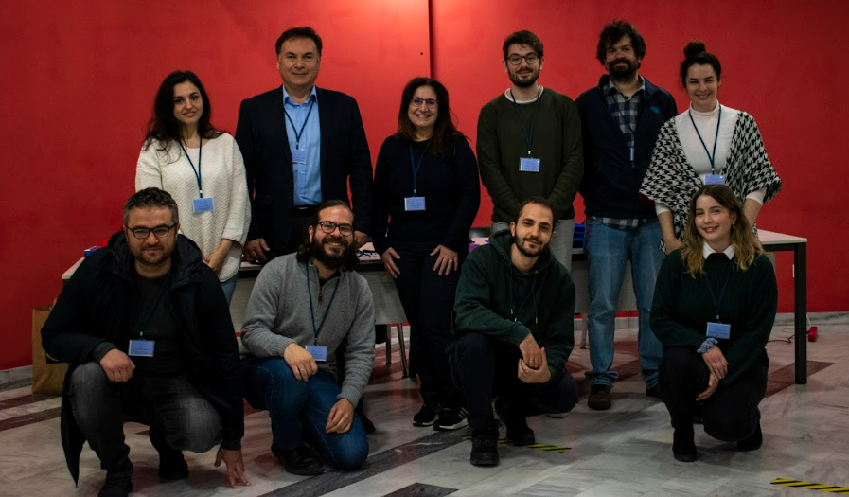

Isabel Cordero-Carrión
@FuturaConjetura
Outreach session

Slide 2
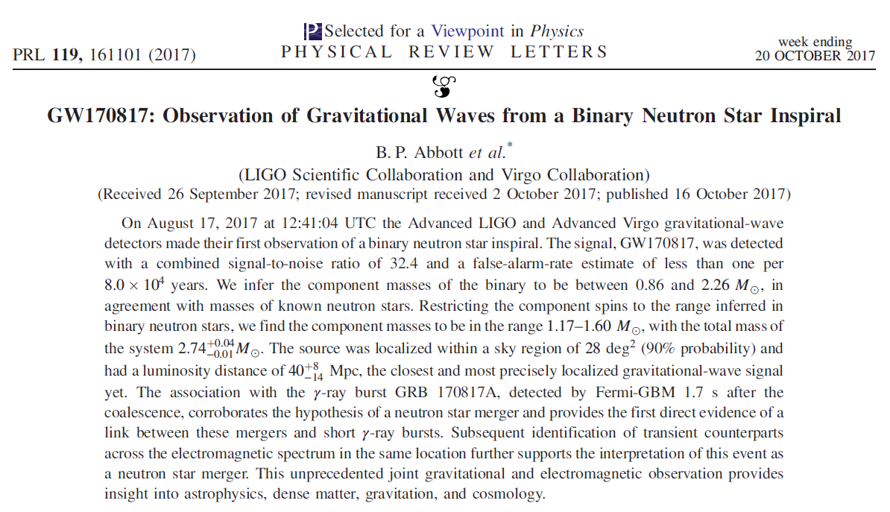
First step. Let's think about my favourite scientific contents...
You can also think about simpler o more basic ideas... and get a lot of followers!!
→ Is the 1/x function continuous? ←

Slide 3
Which is my target public? Do we care of everyone?
Am I thinking about a long-term project or something more exceptional?
Main message
Which is my / their favourite format?
Which resources do I have? Experience... don't care too much: who can help in the project? → TEAM
Which is the initial level of knowledge?
Key points and connection points: outreach is not a scientific article.
Goals: education, fascination, critical thinking, politic decisions, fun...
Why am I going to listen you?
→ MOTIVATION

Slide 4
Example of a recent news in Mathematics: [sorry for potential English typos]
Luis Ángel Caffarelli, Mathematician from Argentina, has been awarded with the Abel Prize 2023. This prize is considered the Nobel Prize for Mathematics and it is the first time it has been given to a Spanish speaker person.
Partial differential equations are equations in which the unknown are functions that depend on more than one variable and that include the proper unknown function and its variation in different directions, the partial derivatives. In a lot of problems we solve these equations considering a fixed place or region: how temperature changes in a square metal plaque. The edge of this place or region is called boundary. Luis A. Caffarelli is the biggest wordwide expert in partial differential equations with free boundary; this means that the boundary is not fixed a priori, its shape is part of the problem we need to solve. A classical example used by Luis A. Caffarelli is how an ice cube melts in a whisky glass, where the ice temperature and the ice cube shape change with time.
→ Proposal for this week...

Slide 5




→ Proposal for this week...

Slide 6
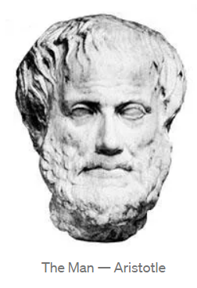
→ Short proposal for this week: short storytelling
·· Pick up a simple idea. 5 minutes long.
·· Pick up a target public.
·· Pick up one of the following two options: short monologue / video.
Don't panic!!! You just need to write the script...
·· Deliver your script on Thursday to the outreach lecturer by email: isabel.cordero@uv.es (also in my identifier).
·· Announcement of selection of works on Friday at the end of the school, if not too many, or as soon as possible by email.
Storytelling, what is it?
- Ancient Greek art! Welcome Mr. Aristotle.
- Develop imagination by introducing your public in a story. Not just information, exchange experiences, taking into account who is your audience.
- Use pictures, different characters, humor (!), close references, music and silence, surprises and conclusion... to support your story.
- Science is fascinating enough!!

Slide 7

Patterns – Signals from the Universe, outreach product financed by G2net – science and people doing science.
·· Filmed in English, texts and subtitles in English: more than 280 views.
https://www.youtube.com/watch?v=bFgMgrE64rw&list=PLRQChI0vpMP7NKYbImJXsvNtIF-C_tj-l&index=2
·· Filmed in English, texts and subtitles in Spanish: more than 520 views.
https://www.youtube.com/watch?v=C-pKTnOLTyQ&list=PLRQChI0vpMP7NKYbImJXsvNtIF-C_tj-l&index=3
·· Open to other languages.

